Slide 1
RÉsumÉ and cover letter workshop
Christian James Barimbao
January 30, 2024
Video and Image Processing Laboratory
(Main reference: Essentials of Business Communication, Guffey and Leowy 12th ed.)
Notes:
Also include a brief discussion between the difference of a Resume and a CV.

Slide 2
Objective
The goal of your résumé is to pass Applicant Tracking Systems and gain an interview from the Hiring Manager.
The objective of this workshop is to create an engaging résumé and a supporting Cover Letter tailored to a particular job post.

Slide 3
Outline
Part 1 – Organizing your Résumé
Choosing Résumé style and length
Hands-on activity
Part 2 – Writing your Cover Letter

Slide 4
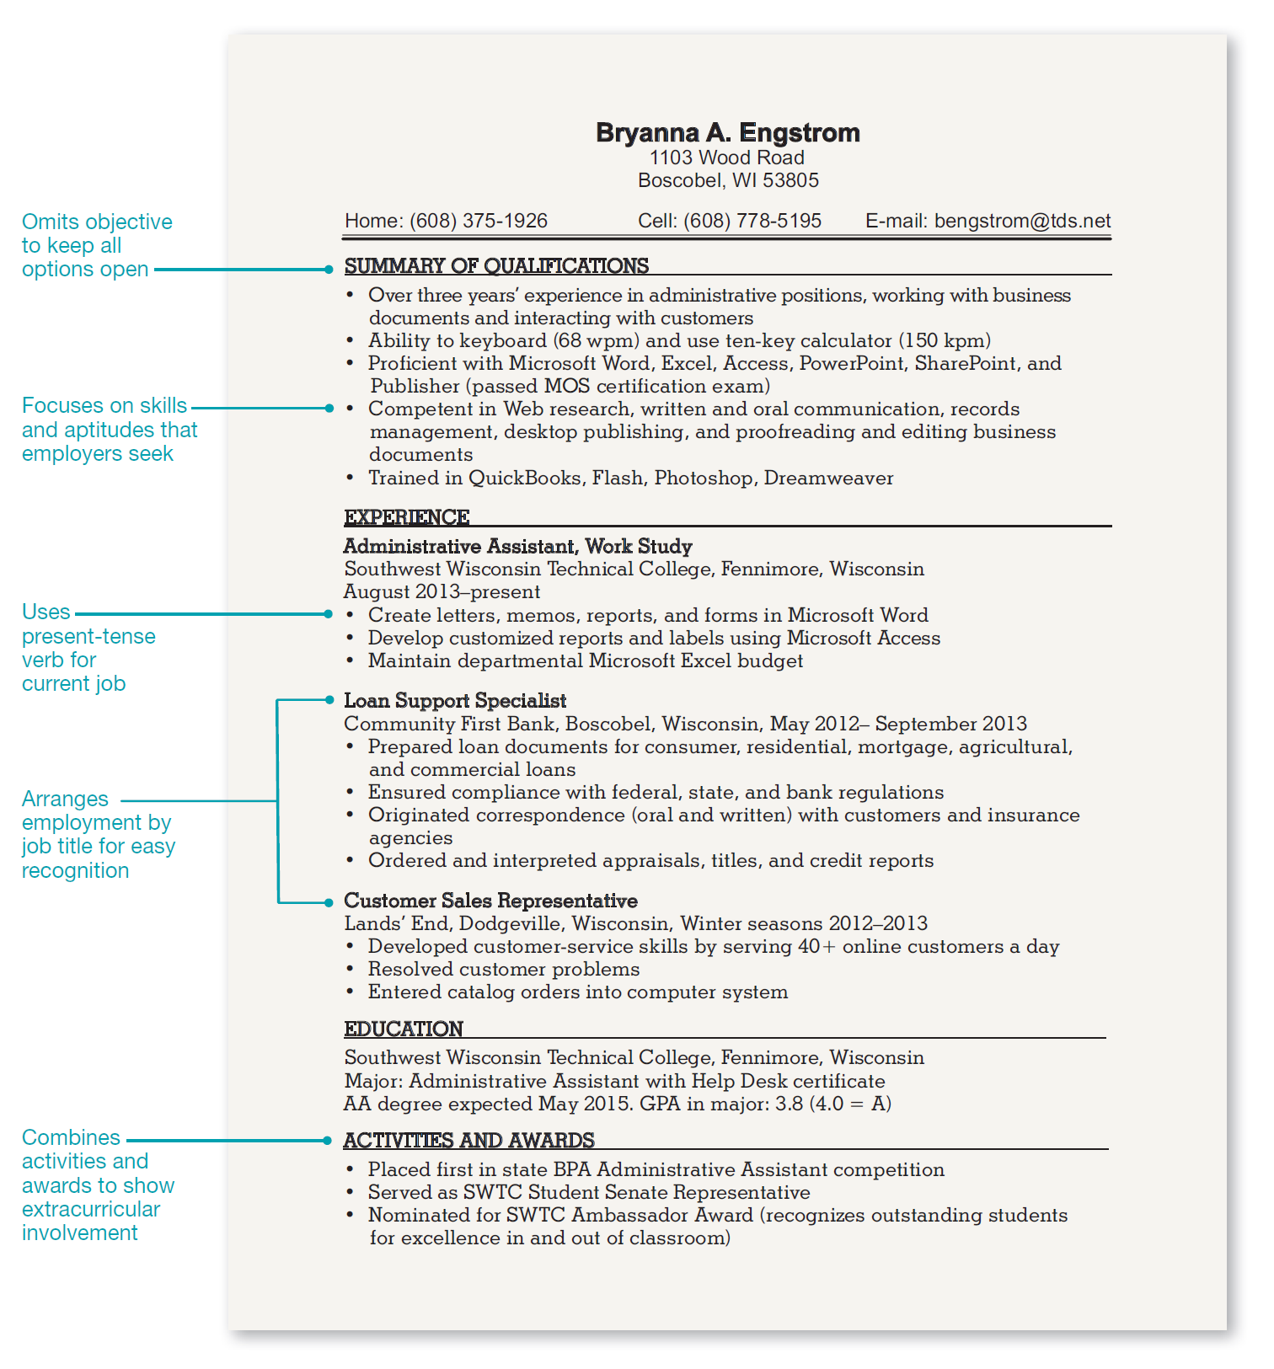
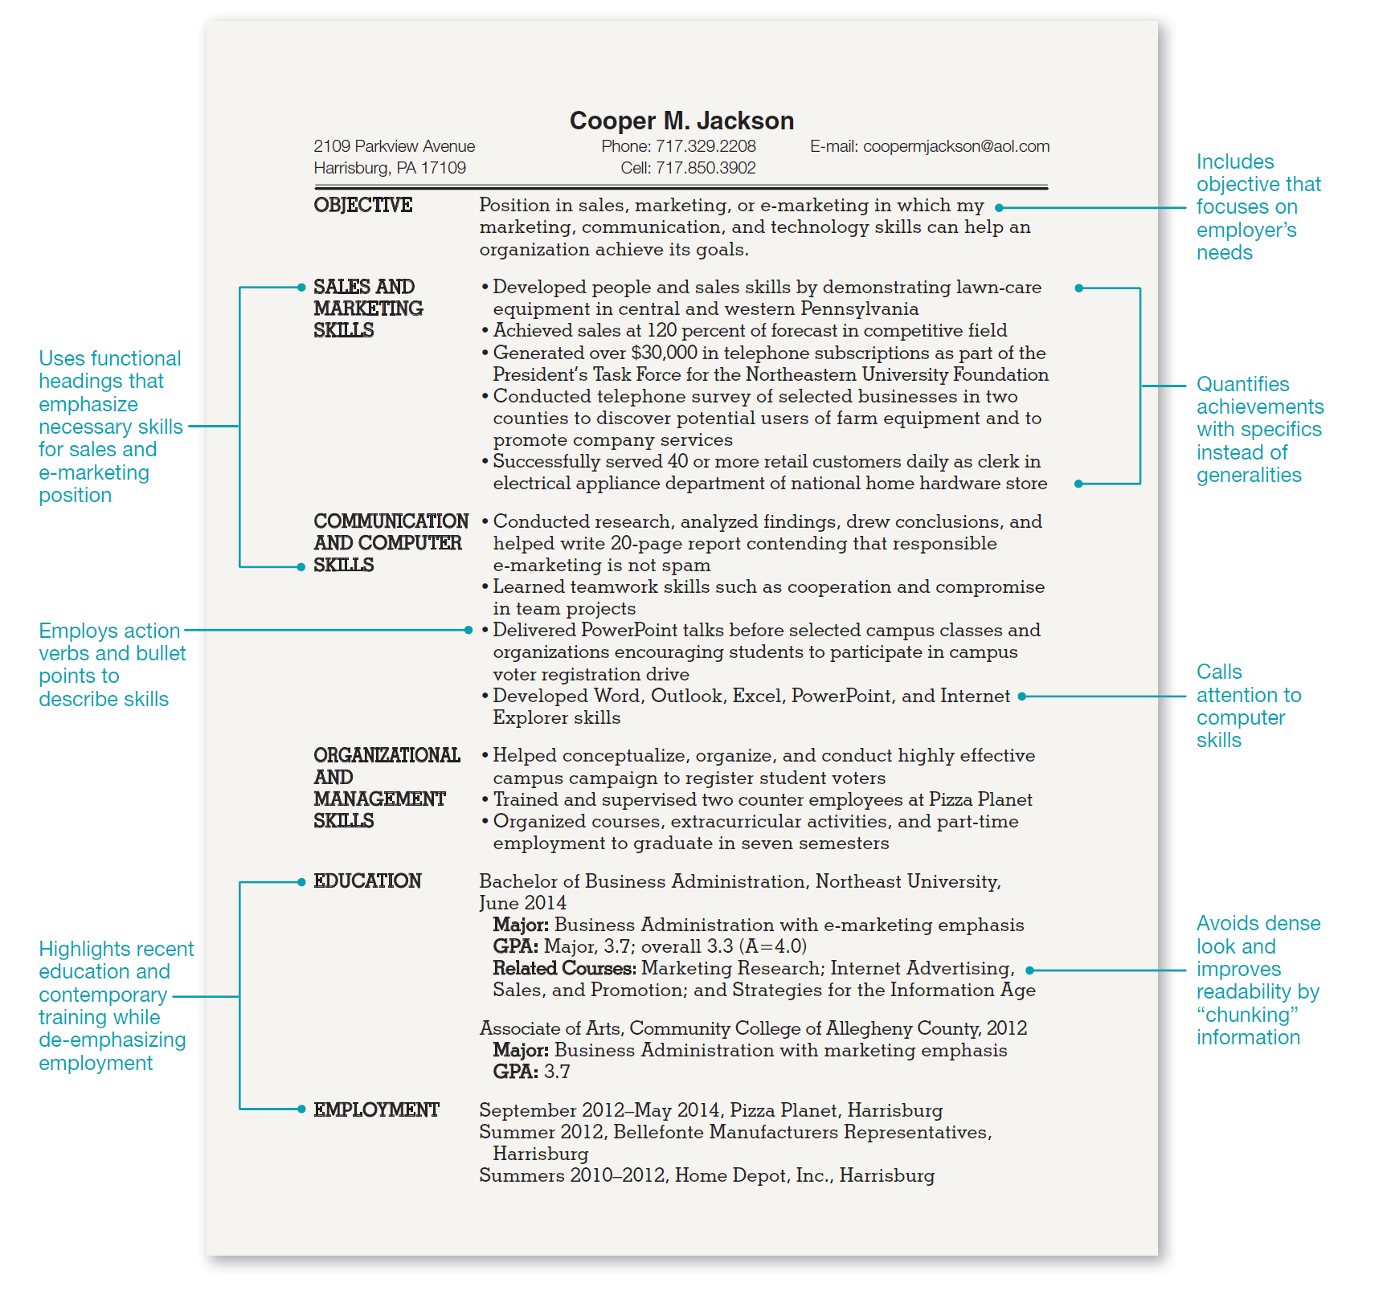
Résumé style
Chronological
Functional
Notes:
Chronological – Recent graduate with related experience
Functional – Recent graduate with unrelated part-time experience

Slide 5
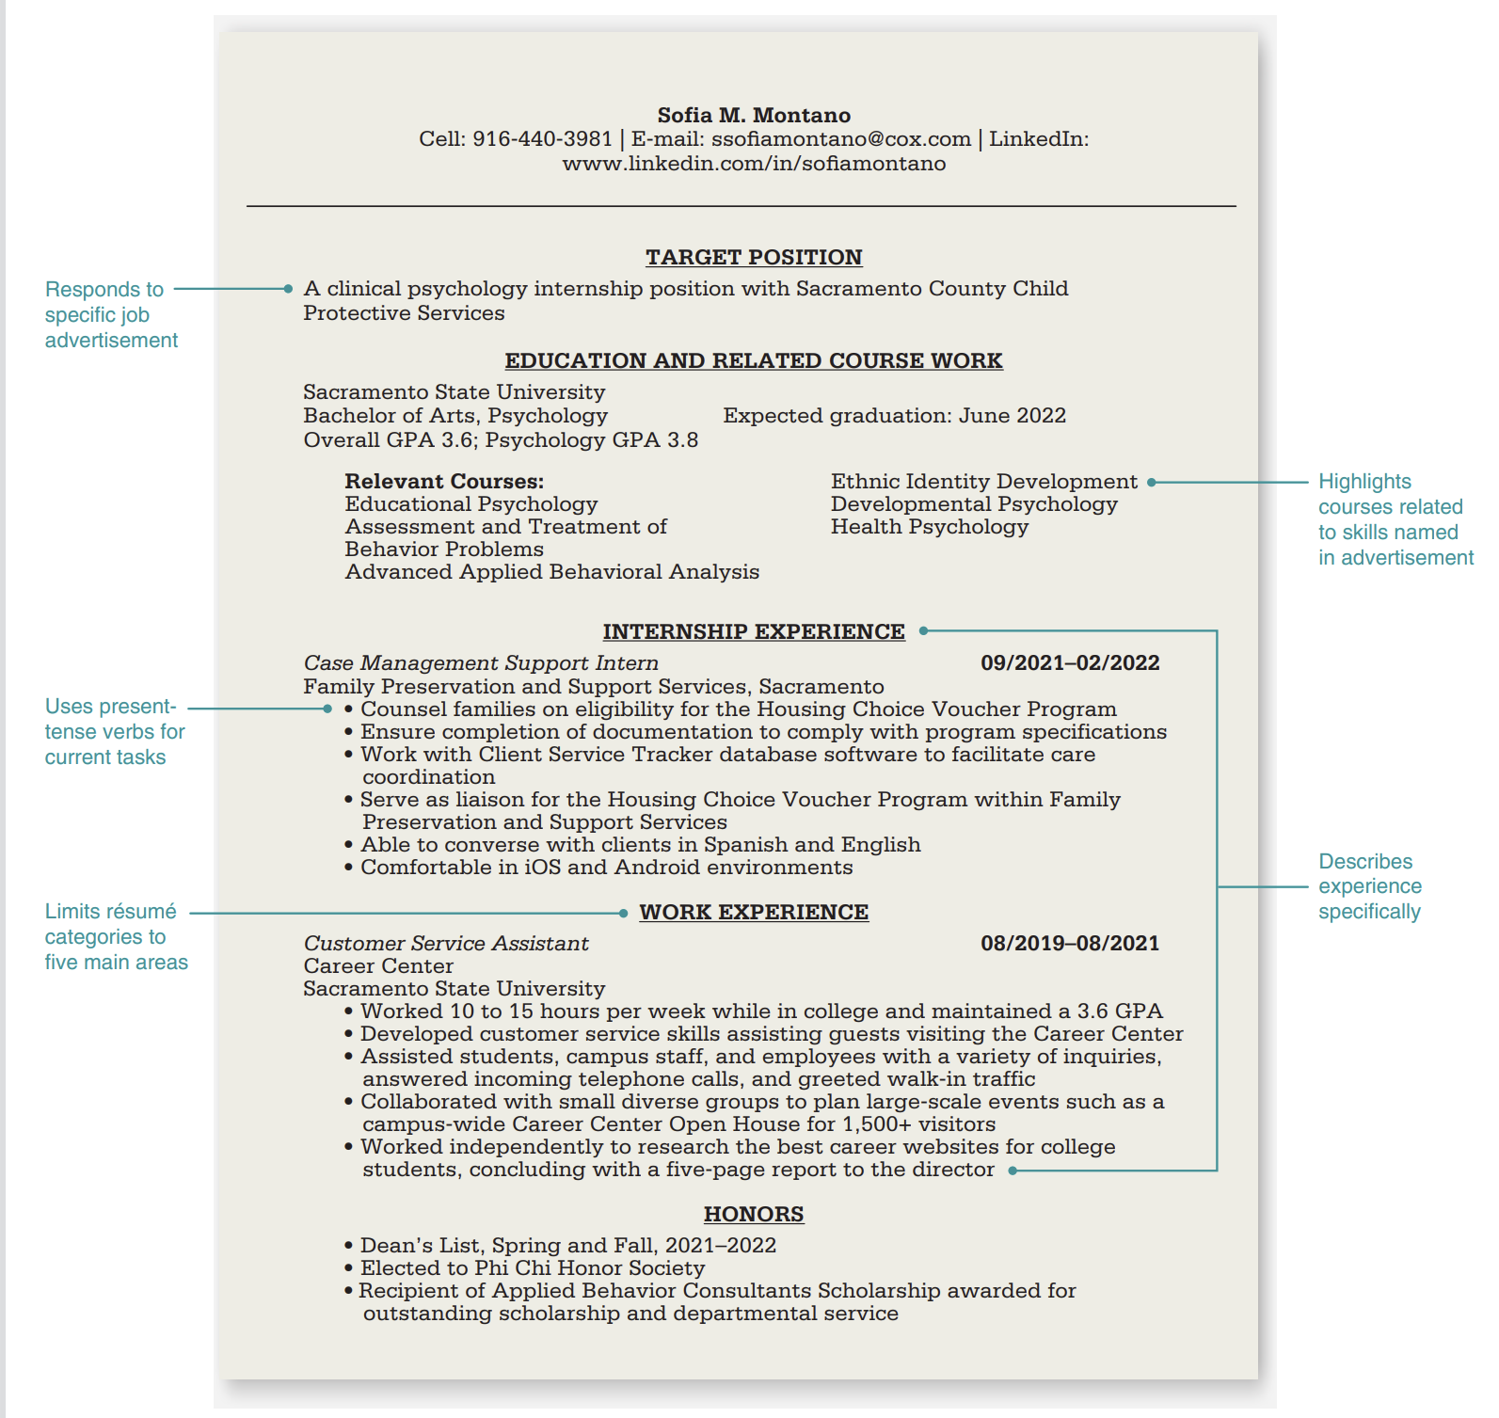
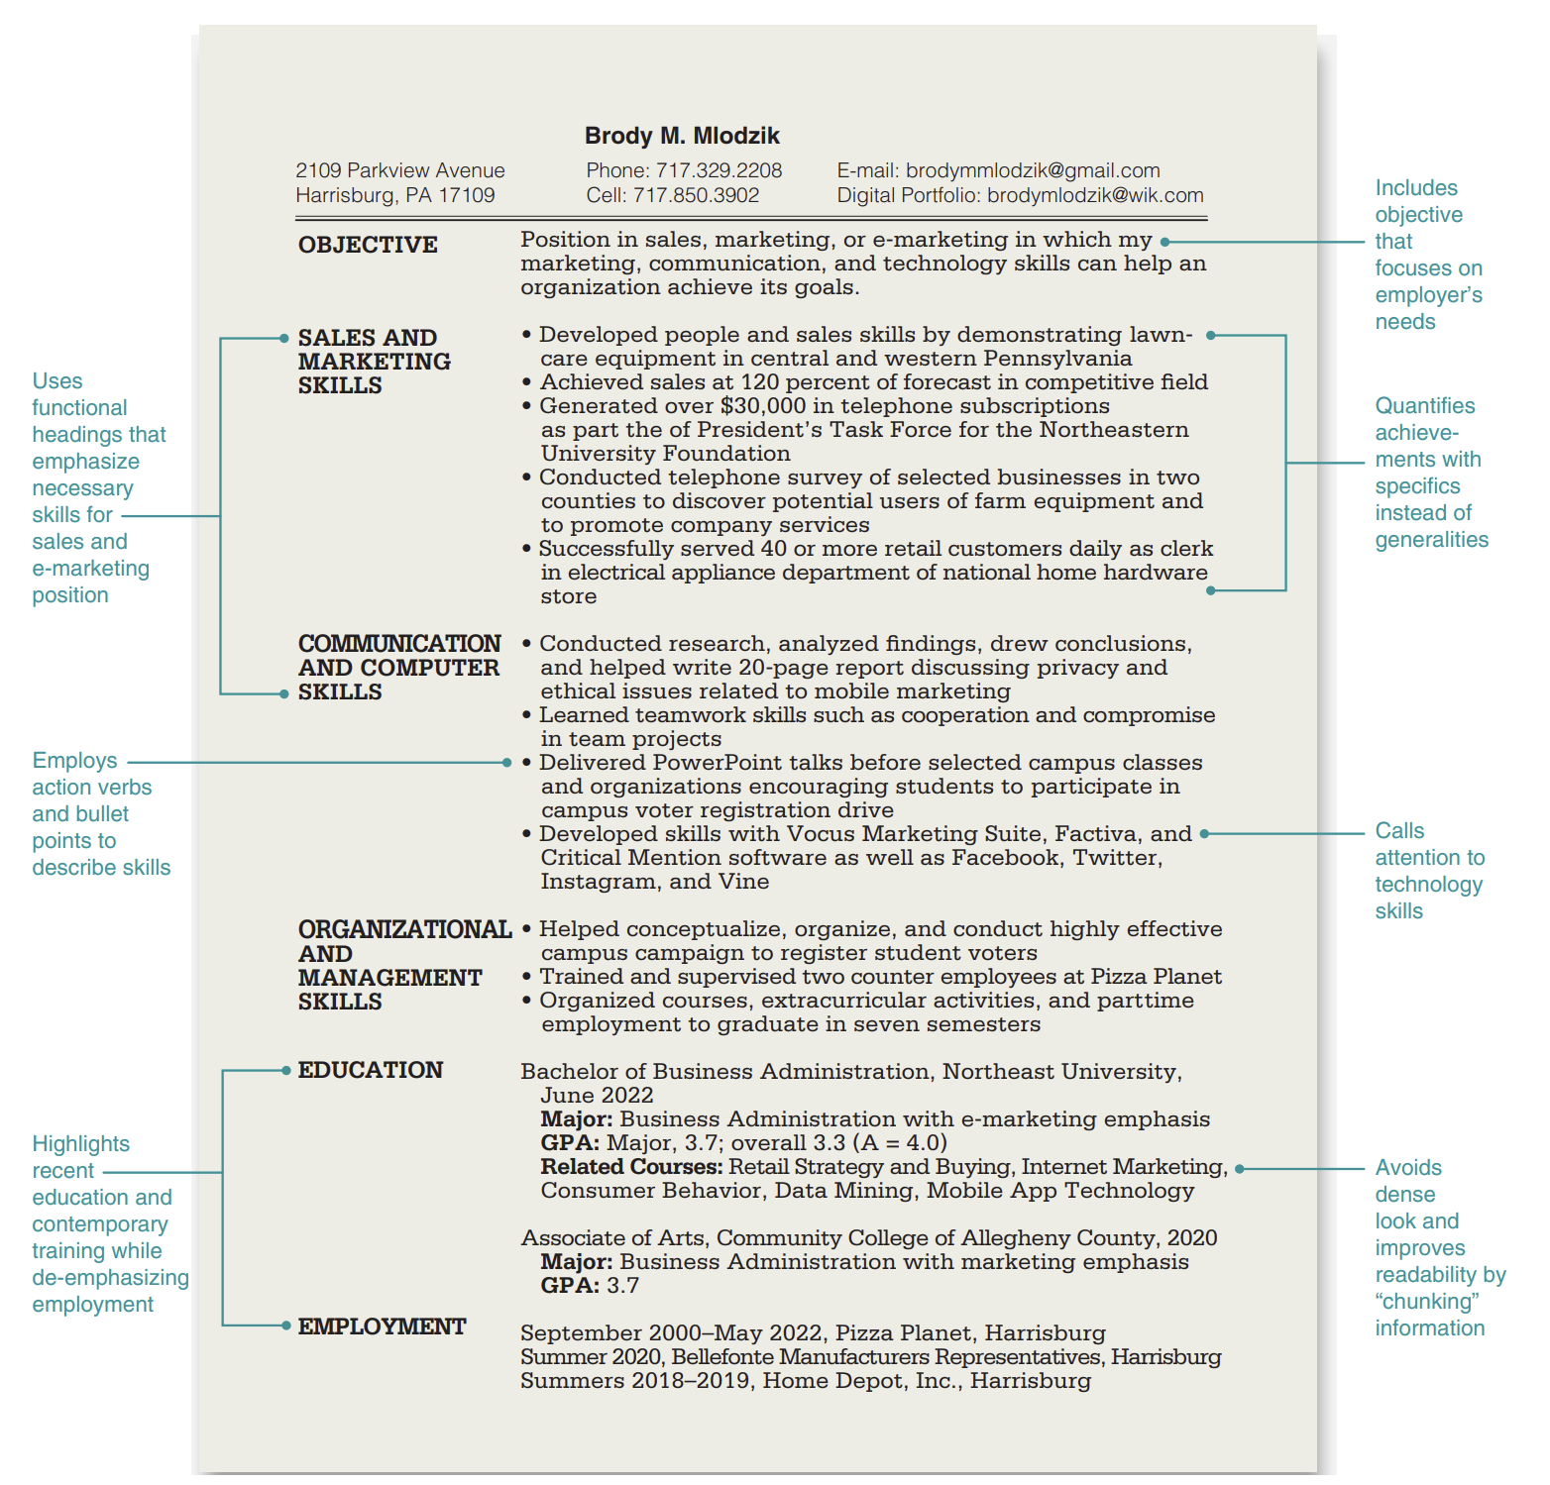
Résumé style
Chronological
Functional
Notes:
Chronological – Student seeking internship
Functional – Recent graduate with unrelated part-time experience

Slide 6
Every résumé should be tailored for every job application
Unrelated job postings will each require a separate résumé

Slide 7
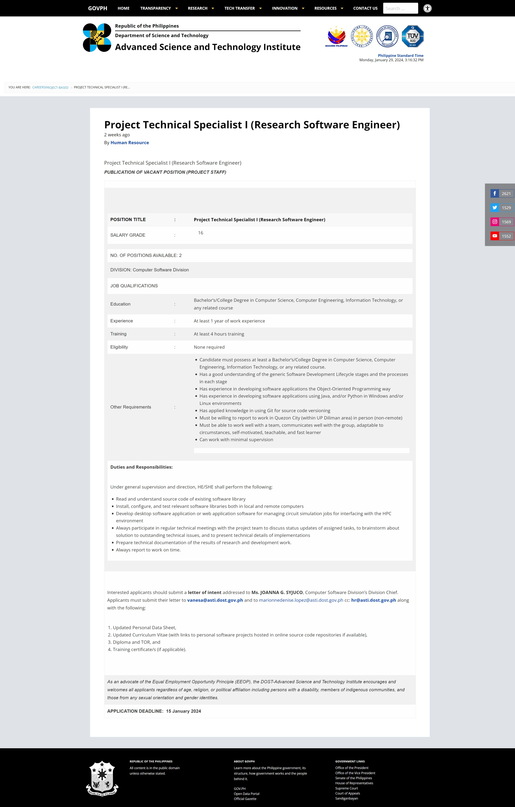
Sample job posting

Slide 8
Resume content
Maximize space
Quantify achievements
Use action verbs (Action Verbs List - Purdue OWL® - Purdue University)

Slide 9
Cover letter writing

Slide 10
THANK YOU
References consulted:
Guffey, M.E. and Leowy D., Essentials of Business Communication 12e, 10e
Ancheta, M.R., English 30 Course Materials 1sAY2022-2023 (UPD DECL)
https://owl.purdue.edu/owl/job_search_writing

